Slide 1
Simulation & Physics
2016-2017

Slide 2
PRACTICAL 5
Collisions, Inelastic Bounce, Mass

Slide 3
Inelastic bounces
velocity = vel.x + vel.y
velocity = -bF*vel.x + vel.y
bF: bounceFactor, 0 <= bF <= 1
velocity = velocity – (1 + bF)*vel.x

Slide 4
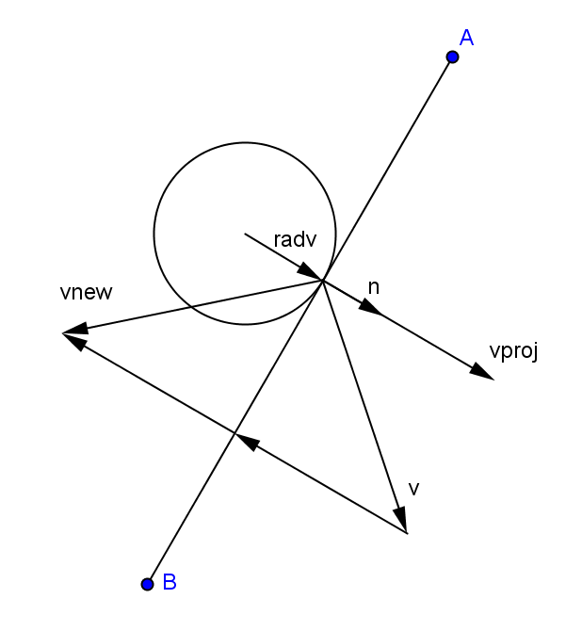
Inelastic bounce on line
v : velocity before bounce
n : normalized normalvector
vproj : projection of v onto n
vnew : velocity after bounce
vnew = v – (1+bF)*(v · n) n
velocity change
vnew = v – (1 + bF)*vproj
vproj = (v · n) n

Slide 5
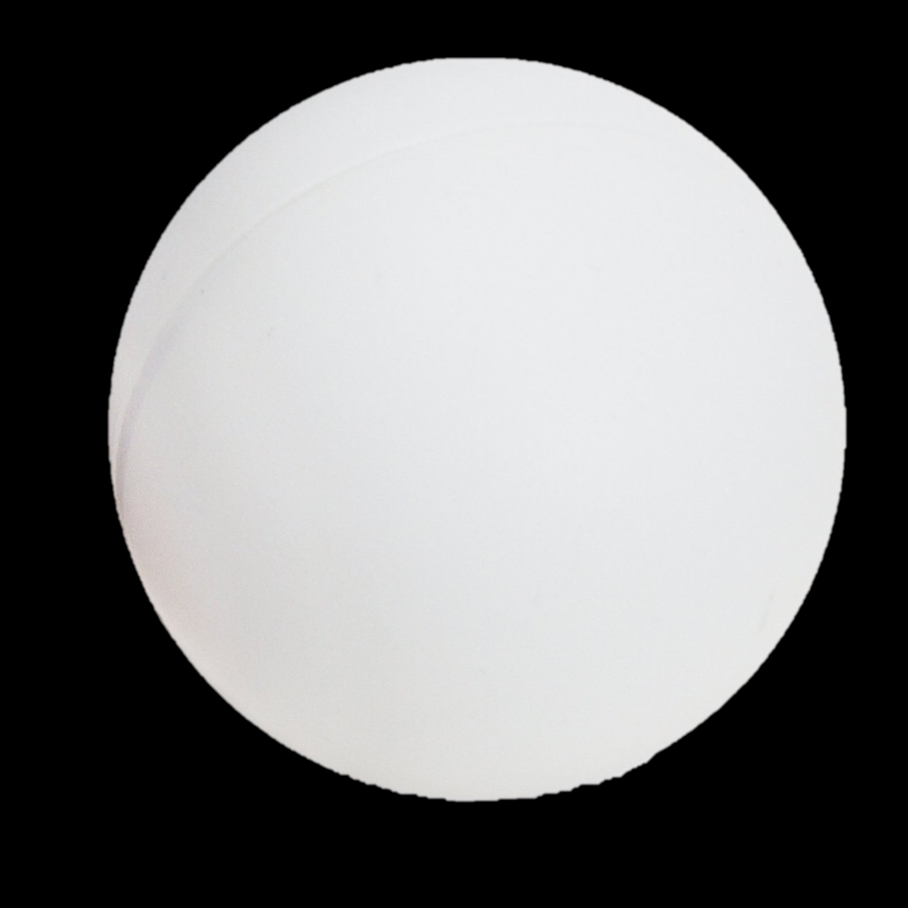
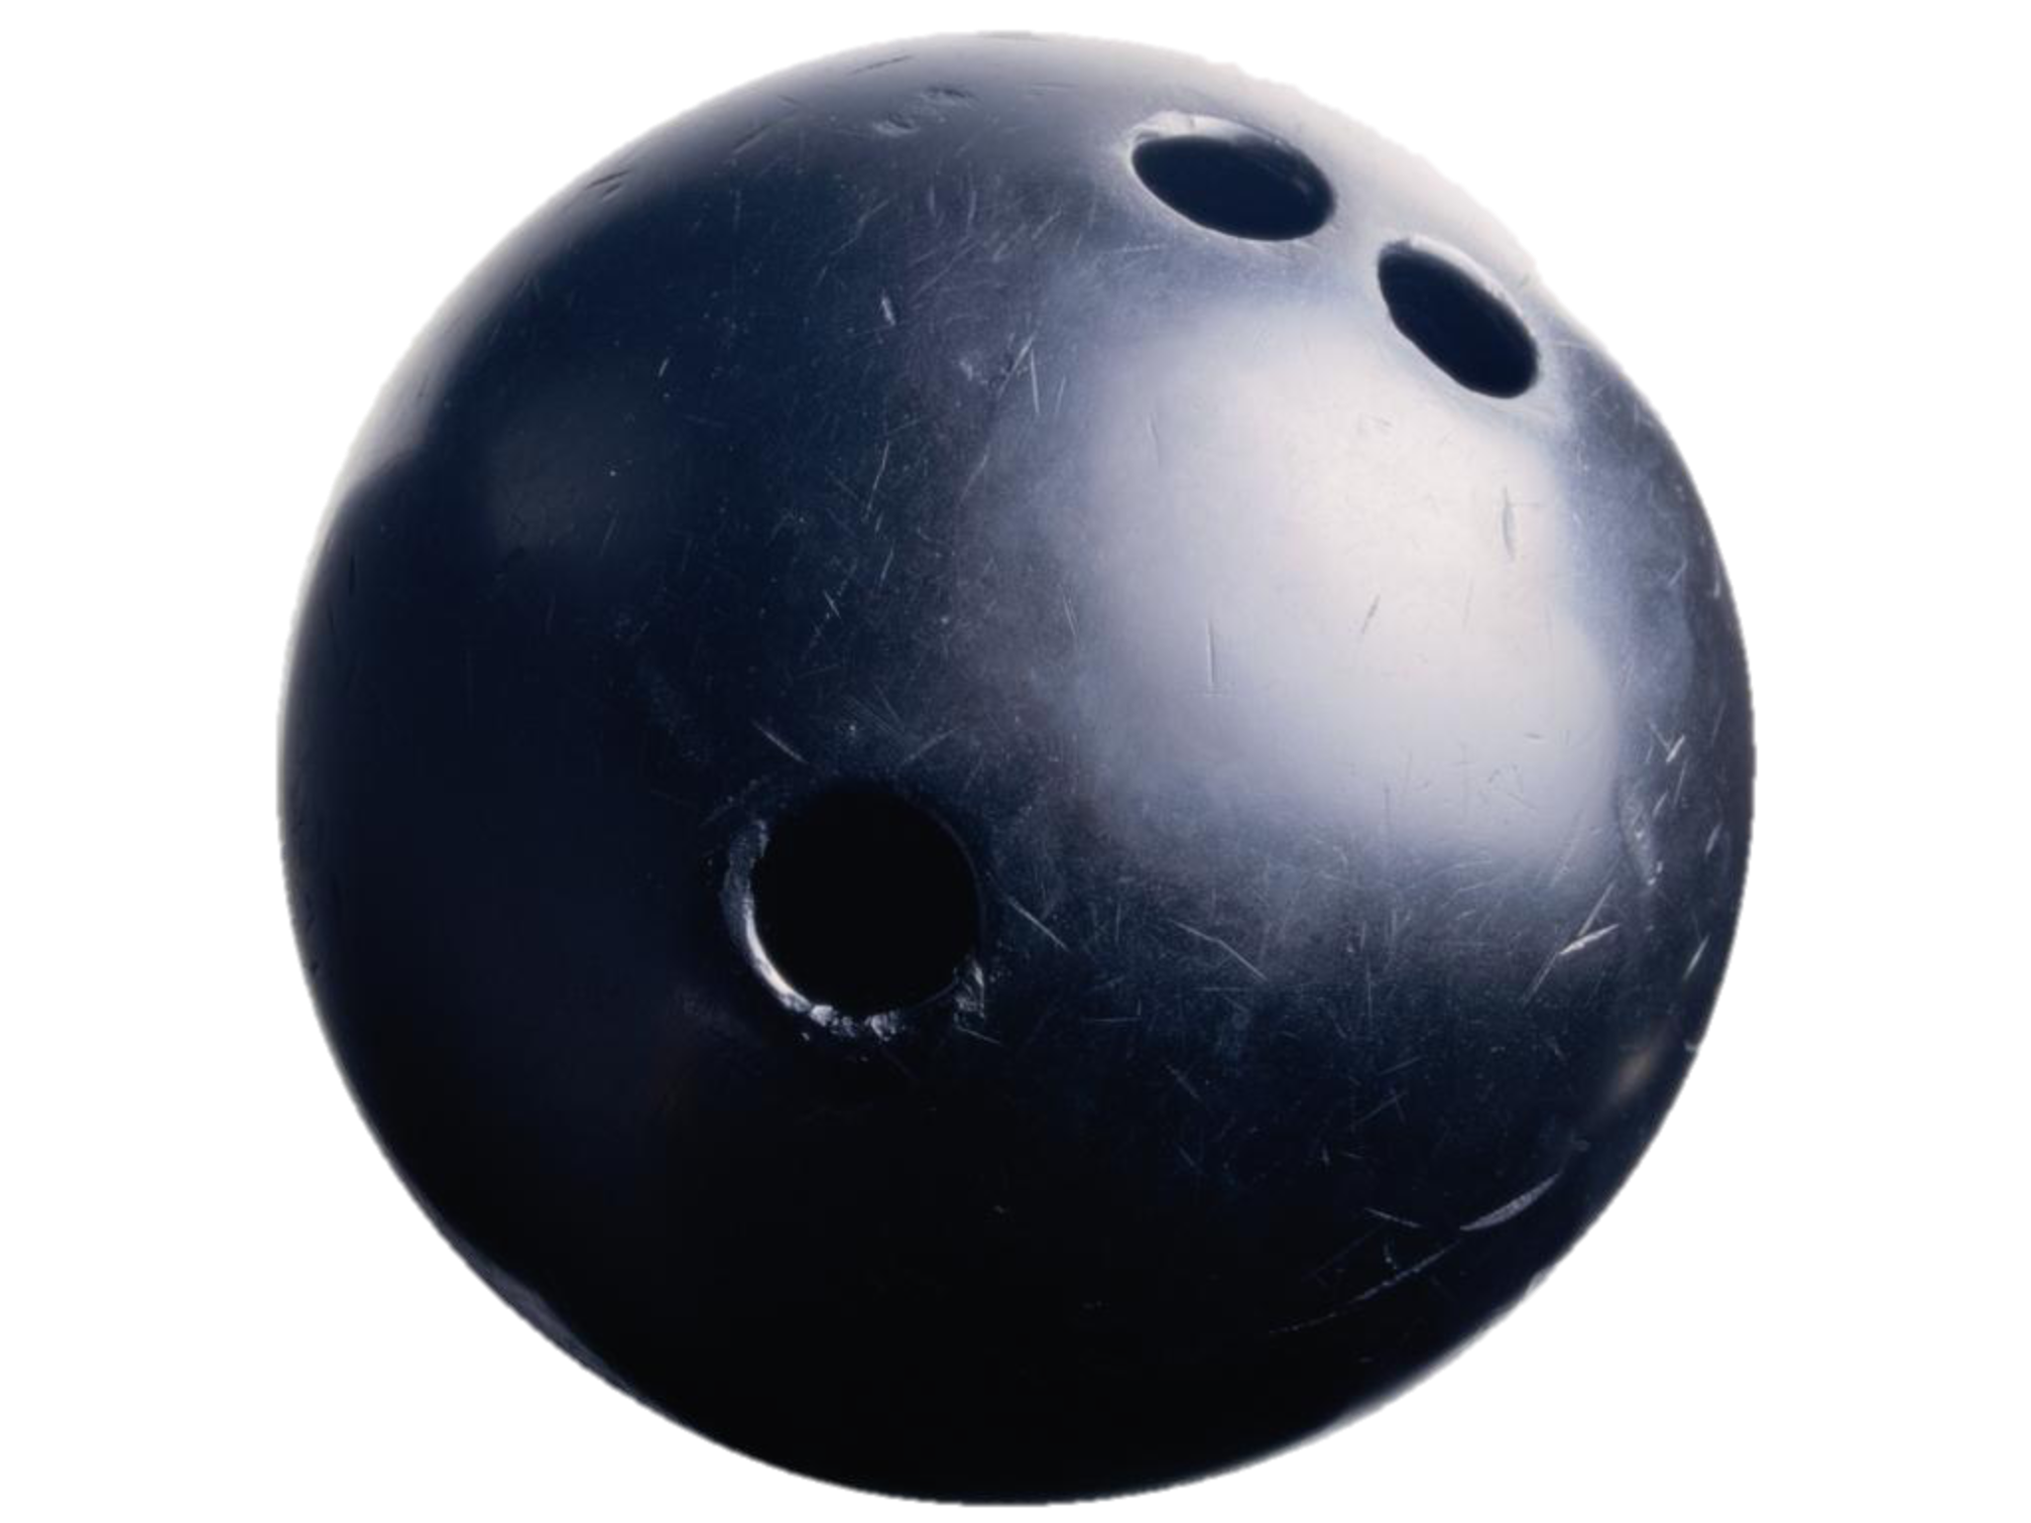
Different mass
mass1
mass2

Slide 6
Momentum
How hard is it to stop an object?
More velocity and more mass make it harder:
p = m∙v
Momentum is a vector parallel to the velocity
Law of Conservation of Momentum:
Total momentum of a system after collision is the same as before collision

Slide 7
Kinetic Energy
How much action can an object perform?
More velocity and more mass give it more energy:
KE = ½∙m∙|v|²
Note: Kinetic Energy is not a vector, but an amount (using the length of the velocity vector)
Law of Conservation of Energy:
Total Energy of a system after collision is the same as before collision

Slide 8
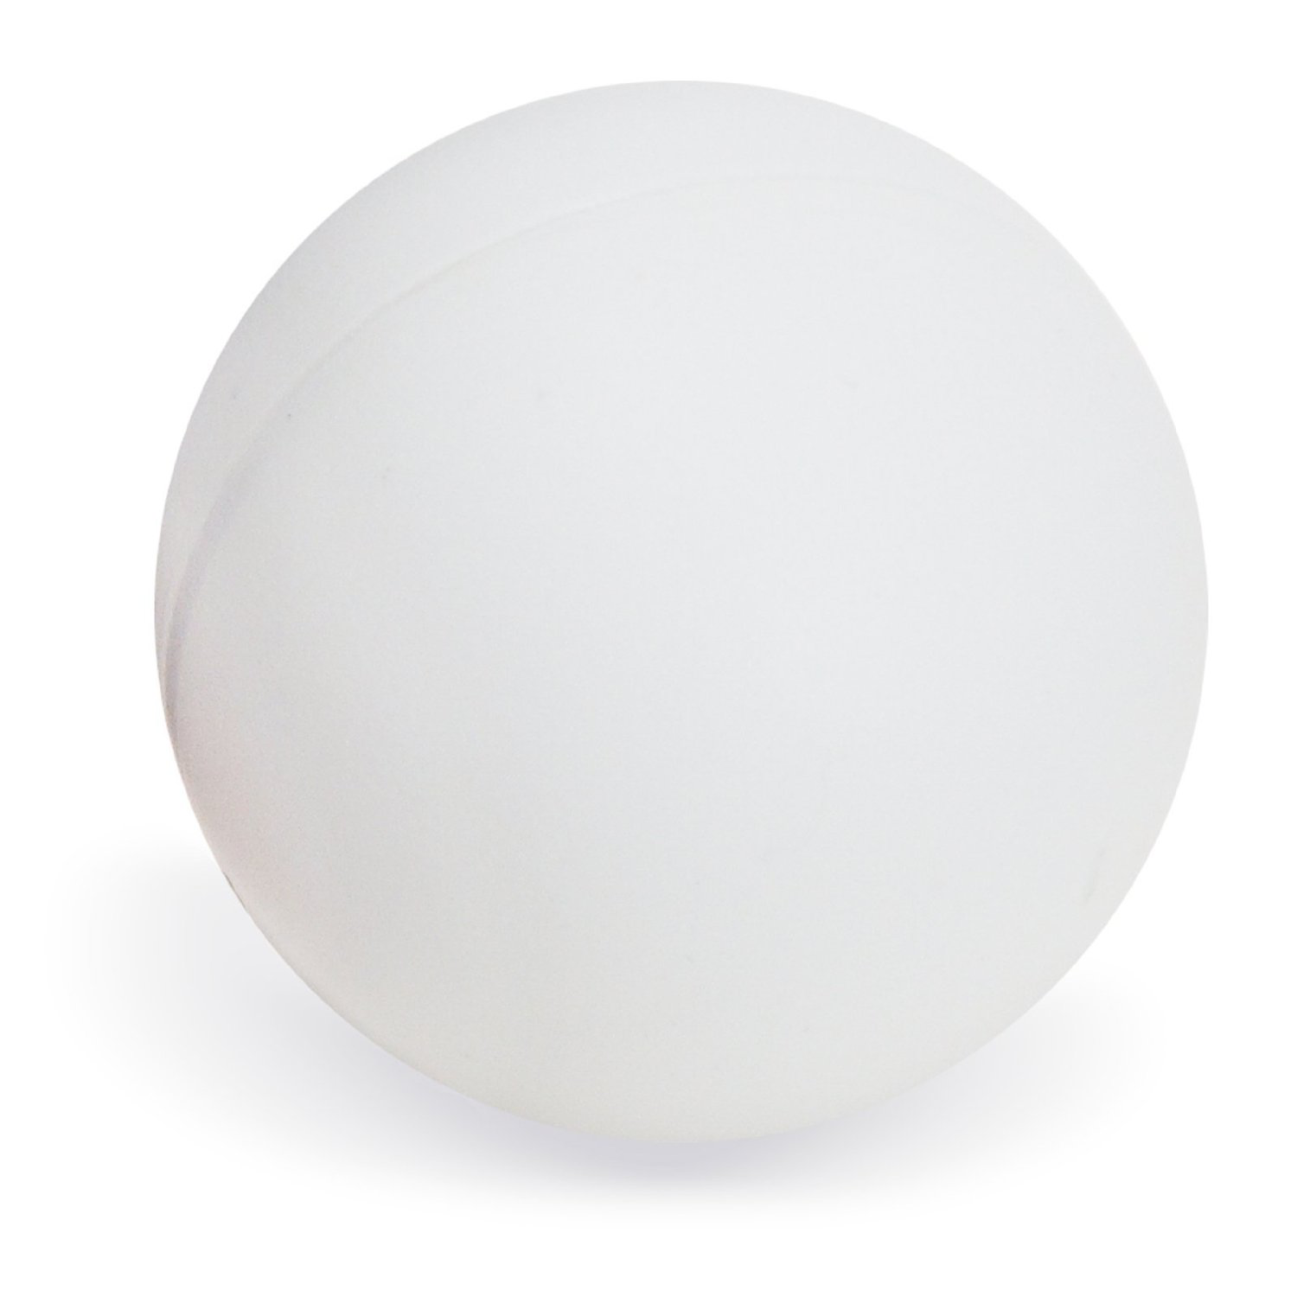
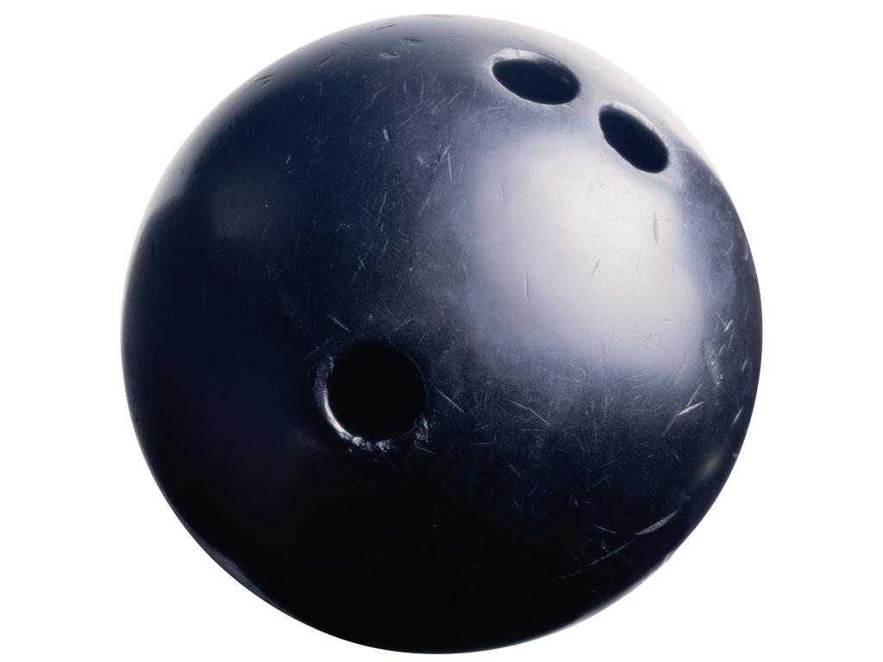
ball1
velocity1
velocity2
ball2
mass1
mass2
ball1
ball2
??
ball1
ball2
??

Slide 9
Colliding balls, different mass
ball1 with mass m₁ and velocity v_{1,pre} before collision
and velocity v_{1,post} after collision
ball2 with mass m₂ and velocity v_{2,pre} before collision
velocity v_{2,post} after collision
Law of Conservation of Momentum:
m₁ ∙ v_{1,post} + m₂ ∙ v_{2,post} = m₁ ∙ v_{1,pre} + m₂ ∙ v_{2,pre}
1
Law of Conservation of Energy:
½∙m₁∙|v_{1,post}|² + ½∙m₂∙|v_{2,post}|²
= ½∙m₁∙|v_{1,pre}|² + ½∙m₂∙|v_{2,pre}|²
2

Slide 10
Simplification
1. Ball2 has no initial velocity
➔ v_{2,pre} = 0
2. Balls move horizontally
➔ velocities are numbers, not vectors
Solve for v_{1,post} and v_{2,post} :
{
m₁∙ v_{1,post} + m₂∙ v_{2,post} = m₁ ∙ v_{1,pre}
1a
m₁∙|v_{1,post}|² + m₂∙|v_{2,post}|² = m₁∙|v_{1,pre}|²
2a
After hard work:
v_{1,post} = (m₁ − m₂) ∙ v_{1,pre} / (m₁ + m₂)
v_{2,post} = 2m₁ ∙ v_{1,pre} / (m₁ + m₂)

Slide 11
Ball2 with initial velocity
Subtract v_{2,pre} from both velocities (the trick)
Solve for ball1 with velocity v_{1,pre} – v_{2,pre} and
ball2 with zero velocity
Add v_{2,pre} to both solutions
Again hard work:
v_{1,post} = ( (m₁ − m₂)∙v_{1,pre} + 2m₂∙v_{2,pre} ) / (m₁ + m₂)
v_{2,post} = ( (m₂ − m₁)∙v_{2,pre} + 2m₁∙v_{1,pre} ) / (m₁ + m₂)
Notes:
Deze formules berekenen de nieuwe velocities direct, we willen weer naar een berekening op basis van velocity change. Dit staat in de volgende slides. Die zijn de basis voor het algoritme. Je kunt afleiden dat dit tot hetzelfde resultaat leidt als in deze slide.

Slide 12
Work with change in velocity
ball1
velocity1 - velocity2
ball2
mass1
mass2
what is the change in velocity
totalChange = 2*(velocity1 – velocity2)
apply this change using the different masses.
But: it turnes out inverseMass is easier to use

Slide 13
Inverse Mass
stationary (immovable) object should have ‘infinite’ mass, no way to store this or calculate with ‘infinity’
stationary objects have inverseMass = 0
calculations are much easier and apply to velocityChange, see following

Slide 14
Use inverse Mass in collision resolution
use totalInverseMass:
calculate changeVelocity over totalInverseMass :
apply this change to each balls velocity proportional to the inverse mass

Slide 15
New velocity ball1
changeVelocity over totalInverseMass :
apply this change to ball1 proportional to the inverse mass:
You can check that this leads to the same result as in slide 10:
v_{1,post} = ( (m₁ − m₂)∙v_{1,pre} + 2m₂∙v_{2,pre} ) / (m₁ + m₂)
Notes:
Eventueel of het white board uitwerken: je kunt m1 ‘wegstrepen’; dan onder 1 noemer brengen (m1+m2) en haakjes wegwerken, voila!

Slide 16
collision algorithm bounceFactor and mass
calculations as before
find the velocity change:
changeVelocity = (1+bounceFactor)*componentFactor*collisionNormal
calculate totalInverseMass
totalInverseMass = this.inverseMass + other.inverseMass
calculate changeVelocity over totalInverseMass:
changeVelocity = changeVelocity / totalInverseMass
change the velocities proportional to inverseMass:
this.velocity = this.velocity – changeVelocity * this.inverseMass
other.Velocity = other.Velocity + changeVelocity * other.inverseMass
two moving balls
different masses

Slide 17
Practical 5
Download the instructions for practical 5 from the VLO, build further on your solution for practical 5;
Make the following assignment
Collision with inelastic bounce & mass
Hand in your report via VLO group assignments
before June 4th, 23:00

